Slide 1
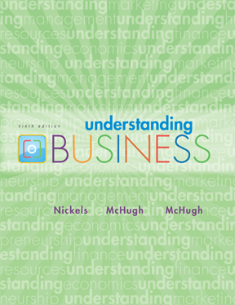
*
Chapter Seven
*
Management and Leadership
McGraw-Hill/Irwin
Copyright © 2010 by The McGraw-Hill Companies, Inc. All rights reserved.

Slide 2

LEADERSHIP
*
Leading: Providing Continuous Vision and Values.
*
LG5
    Leaders must:
    Communicate a vision and rally others around that vision.
    Establish corporate values.
    Promote corporate ethics.
    Embrace change.
    Stress accountability and responsibility
7-<number>

Slide 3
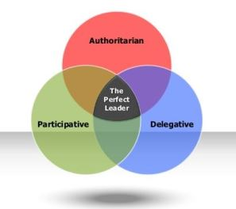
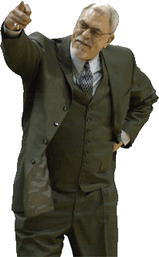
LEADERSHIP STYLES
*
Leadership Styles
    Autocratic Leadership -- Making managerial decisions without consulting others.
    Participative or Democratic Leadership -- Managers and employees work together to make decisions. flexibility, good listening skill, empathy
    Free-Rein Leadership -- Managers set objectives and employees are free to do whatever is appropriate to accomplish those objectives. Warmth, friendliness & understanding
*
LG5
7-<number>
Notes:
mm

Slide 4
LEADERSHIP STYLES
Other concepts:
Directing
Empowerment
Enabling
Knowledge management

Slide 5
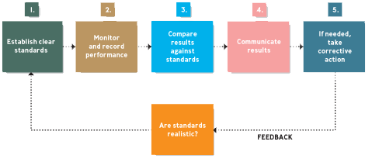
FIVE STEPS of CONTROLLING
*
Controlling: Making Sure it Works
*
LG6
7-<number>

Slide 6
1. Setting Performance Standards:
The first step in the process of controlling is concerned with setting performance standards. These standards are the basis for measuring the actual performance.
Examples of Quantitative Standards:
(a) Revenue to be earned.
(b) Units to be produced and sold.
Examples of Qualitative Standards:
(a) Improving motivation level of employees.
(b) Improving labour relations.

Slide 7
2. Monitor and record performance
Once the standards have been determined, the next step is to measure the actual performance. The various techniques for measuring are sample checking, performance reports, personal observation etc.
3. Comparing Actual Performance with Standards:
This step involves comparing the actual performance with standards laid down in order to find the deviations. For example, performance of a salesman in terms of unit sold in a week can be easily measured against the standard output for the week.

Slide 8
4. Communicating the Results:
The management needs to communicate with the employees about their performance and the feedback if, the performance was satisfactory or not.
5. Taking Corrective Action:
The last step in the process of controlling involves taking corrective action. If the deviations are within acceptable limits, no corrective measure is required. However, if the deviations exceed acceptable limits, they should be immediately brought to the notice of the management for taking corrective measures, especially in the important areas.

